Slide 1
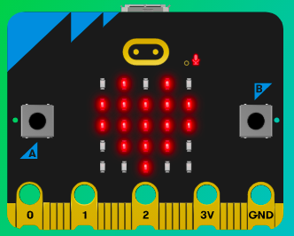
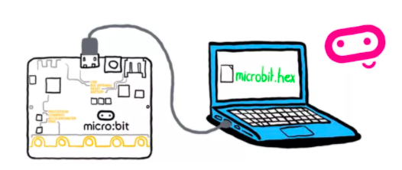
MicroMakers!
KIDS’ MAKER CLUB OF WASHINGTON, DC
Meet Up #17

Slide 2
RECAP!
Notes:
LEDs, Buttons, Light Sensor

Slide 3
RECAP!
What programming languages do you know?
If, Then, Else
Variable
Loops
Circuits – in which direction do electrons flow?
Bugs
Pseudo-code

Slide 4

PYTHON!
Learning a new language is easier when you already know a few!

Slide 5

What is Python?

Slide 6
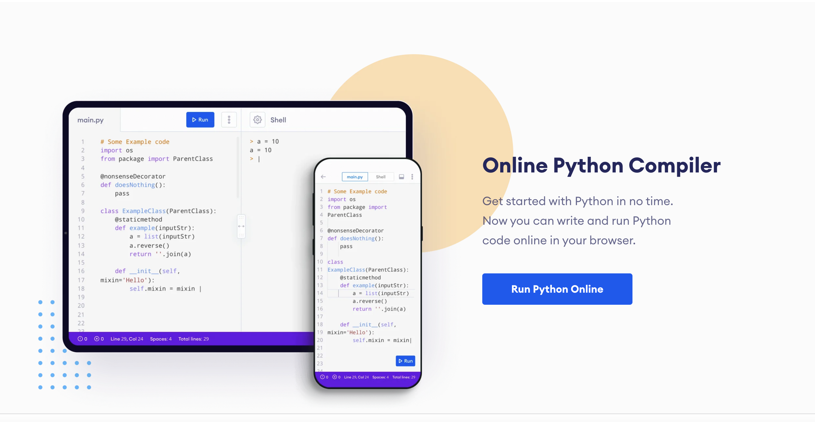
Let’s Get Started
Using an online code editor and compiler
Go to: https://www.programiz.com /
Find and click this button:

Slide 7
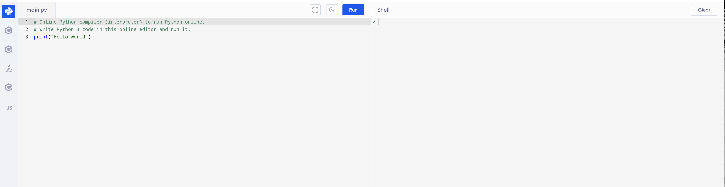
Let’s Get Started
Using an online code editor and compiler

Slide 8
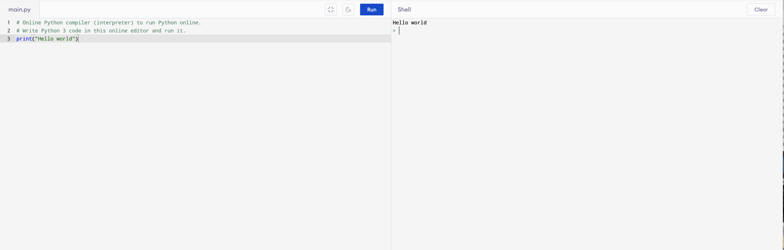
Let’s Get Started
Using an online code editor and compiler

Slide 9
Coding Challenge #1
Using strings and the print statement
Write a program that prints your name.
Write a program that prints your name on one line, and a good pet name on the second line.

Slide 10
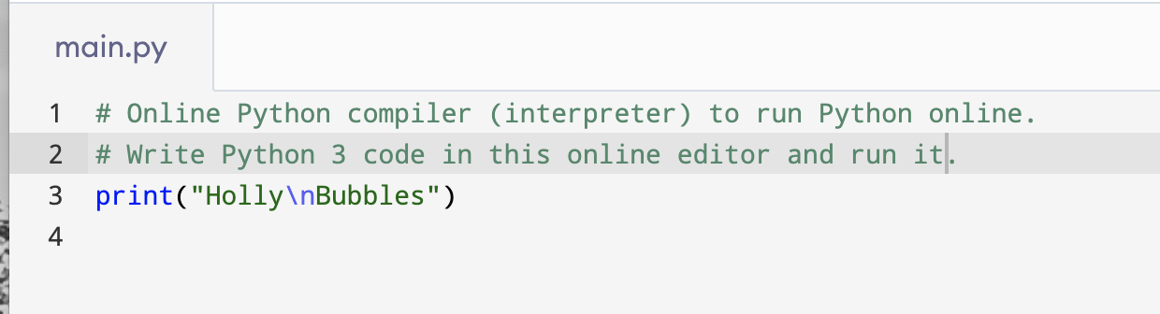
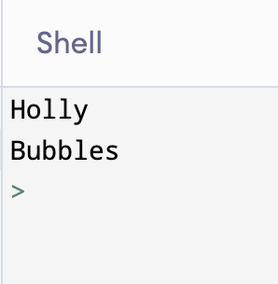
Coding Challenge #1
Using strings and the print statement
Trick! Use \n to add a new line to your print statement.

Slide 11
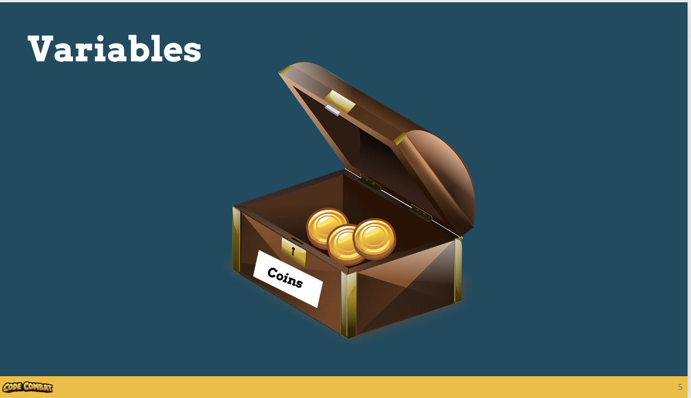

Slide 12
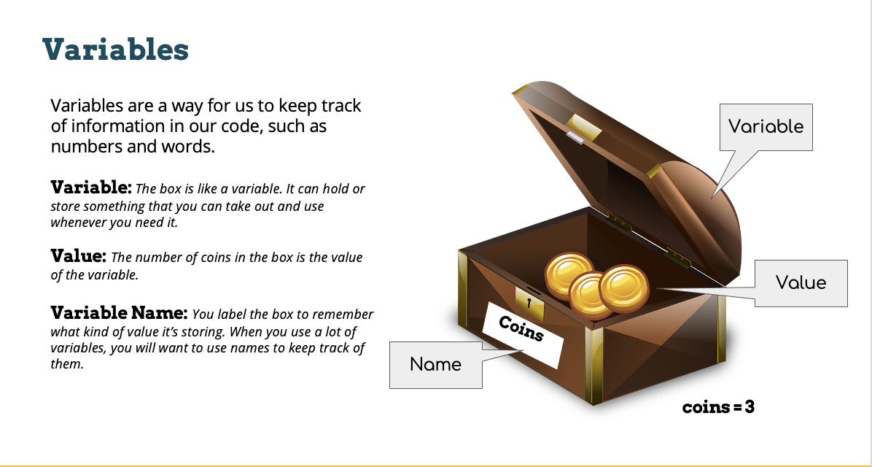

Slide 13
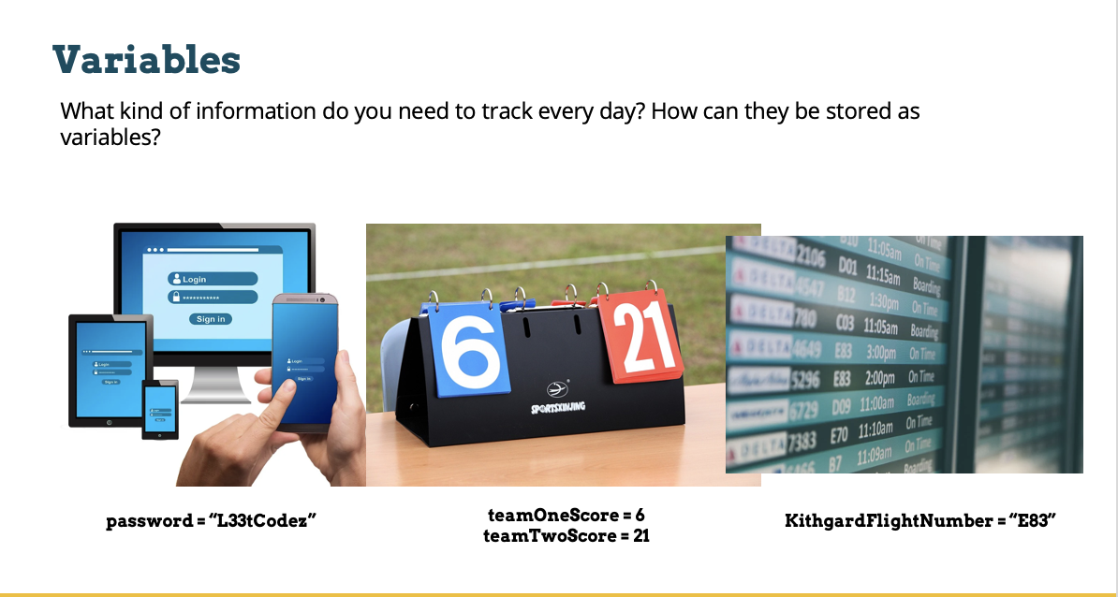

Slide 14
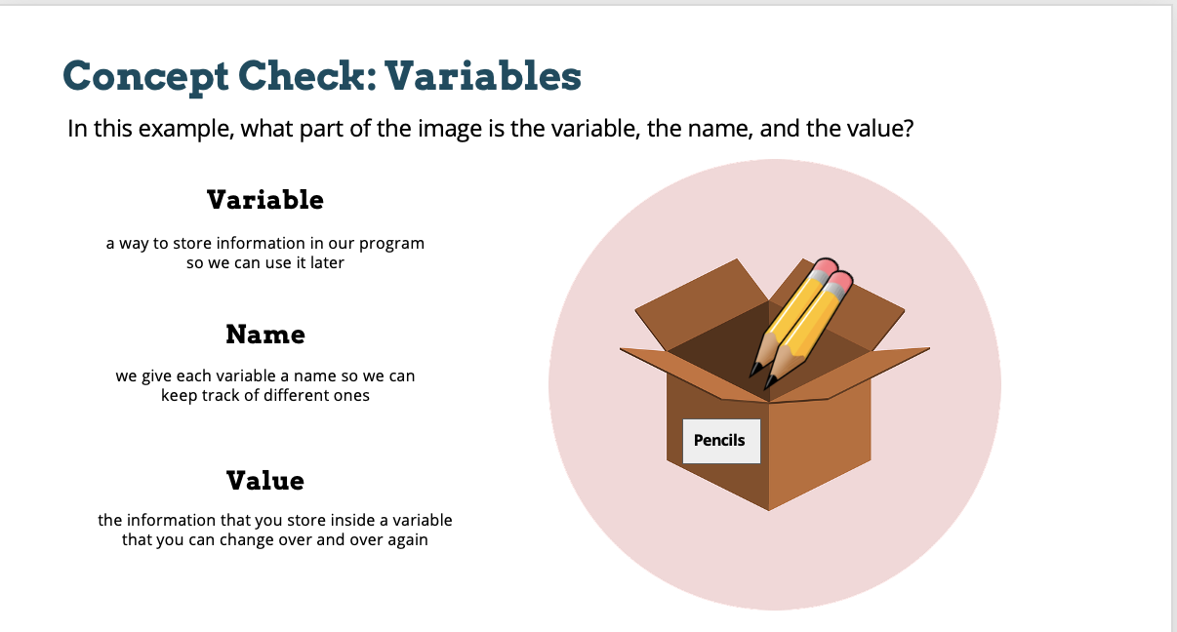

Slide 15
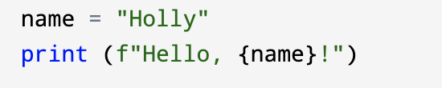
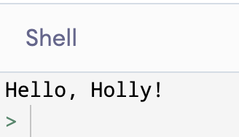
Using Variables

Slide 16
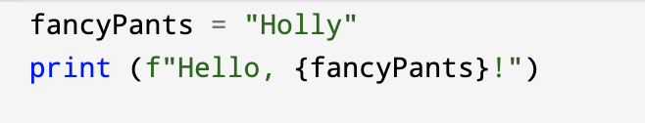
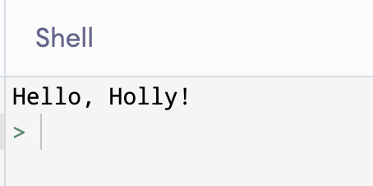
Using Variables

Slide 17

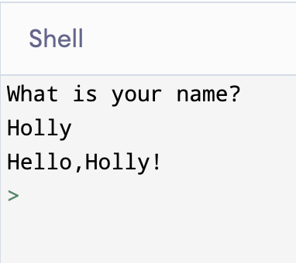
Using Variables and Functions

Slide 18
Coding Challenge #2
Using variables and input functions
Write a conversation program that
Asks for your age
Stores the answer as a variable called “age”
Prints “Hello, you are __ years old!”

Slide 19
Coding Challenge #3
Using variables and input functions
Write a cool band name generator that:
Asks the user to enter the name of a place
Asks the user to enter a pet name
Prints “Your new band name is the place pets!”

Slide 20
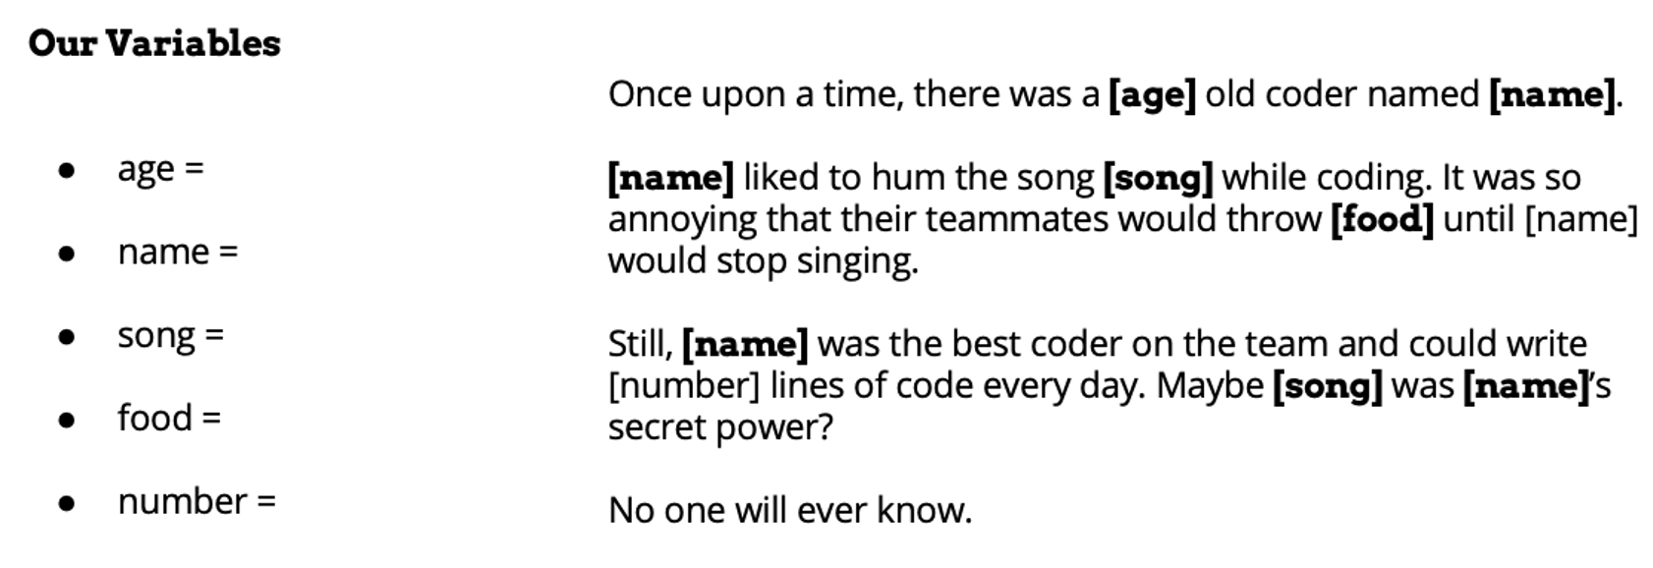
Coding Challenge #4
Using variables and input functions
Write a MAD LIBS program that
Asks for at least three inputs from the user
Prints a custom story.

Slide 21
TIME TO PUT AWAY OUR COMPUTERS!
Neat and tidy, please!
Let’s leave this beautiful room as lovely as we found it!

Slide 22

UNTIL NEXT TIME….
MicroMakers!
Slides and Script: Holly Krambeck (learningpython64@gmail.com)
Variable Slides: https://codecombat.com/

